Slide 1




Heart Failure Prediction
using data minig

Slide 2



Problem
Global Impact of CVDs
Leading cause of death worldwide.
Approximately 17.9 million deaths annually, representing 31% of global deaths.
Statistics and Risk
80% of CVD deaths due to heart attacks and strokes.
One-third of these deaths are premature, occurring in individuals under 70 years.

Slide 3

Data
This dataset, was unprecedented in its scope, merges five previously independent heart datasets across 11 common features, creating the largest heart disease dataset to date for research. The datasets included are:
Dataset Details:
Cleveland: 303 observations
Hungarian: 294 observations
Switzerland: 123 observations
Long Beach VA: 200 observations
Stalog (Heart) Data Set: 270 observations

Slide 4






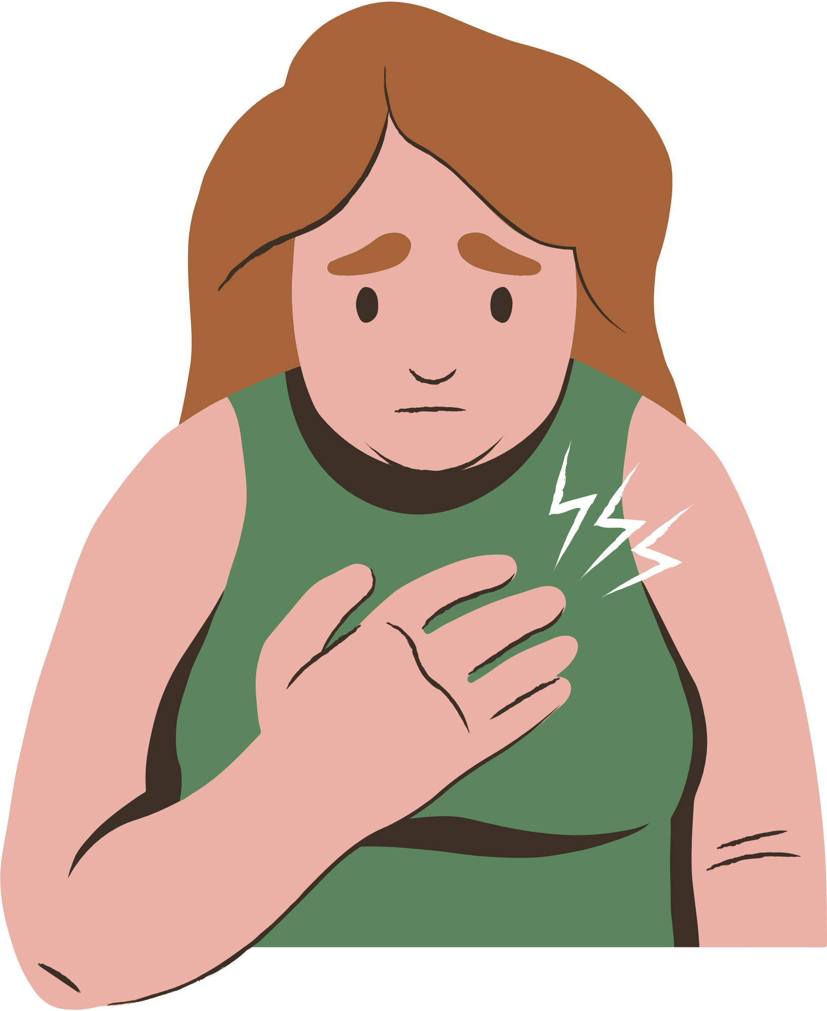

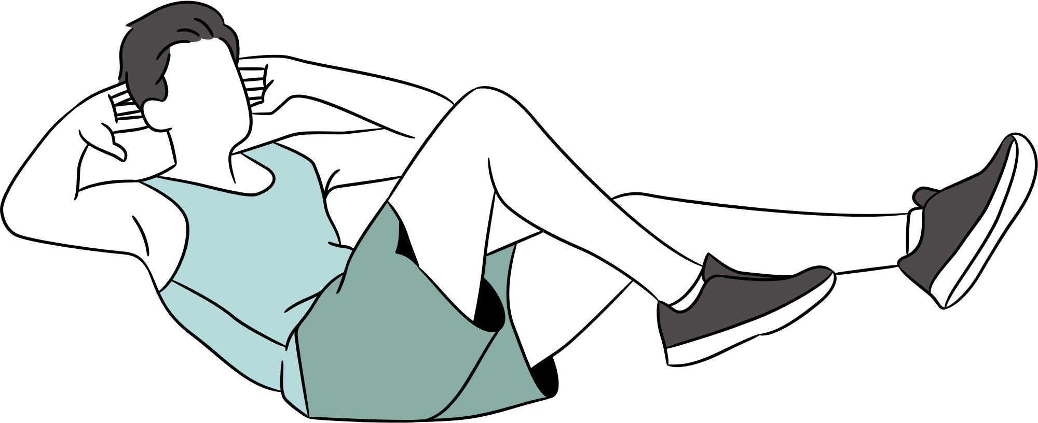

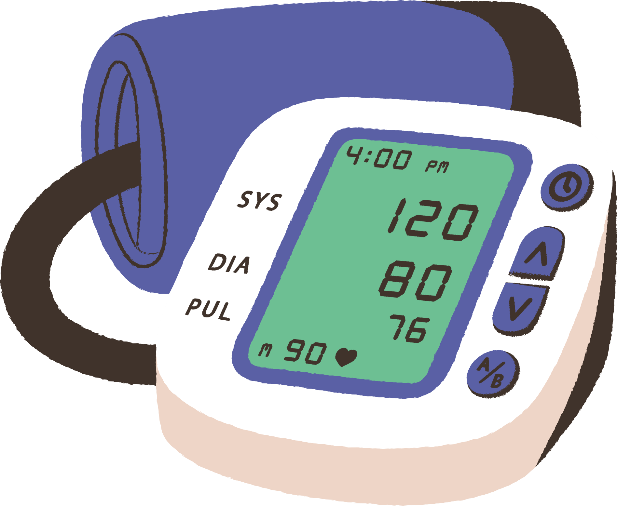
Data
This is the 11 common features was a common between the 5 dataset :
1-Age
5-Cholesterol
9-Exercise-induced Angina (ExerciseAngina)
2-Sex
6-Fasting Blood Sugar (FastingBS)
10-ST Depression (Oldpeak)
3- Chest Pain Type
7-Resting ECG
11-ST Slope
4-Resting Blood Pressure
(RestingBP)
8-Maximum Heart Rate (MaxHR)
class table: HeartDisease

Slide 5
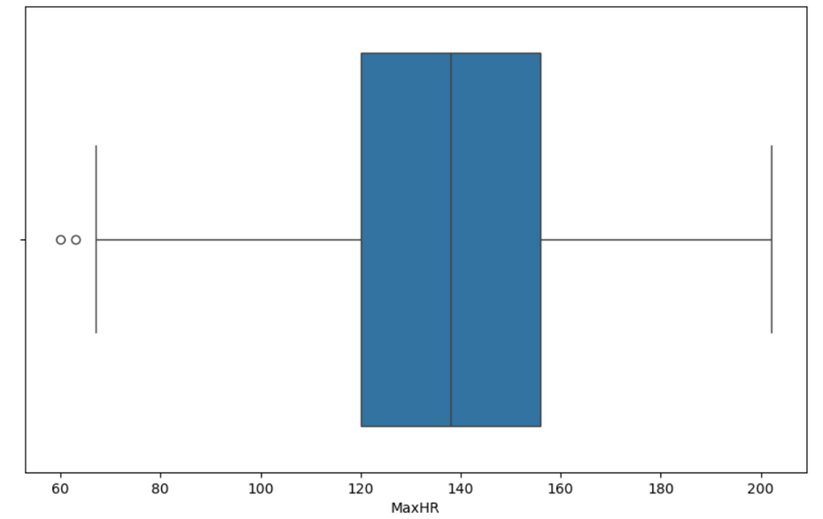
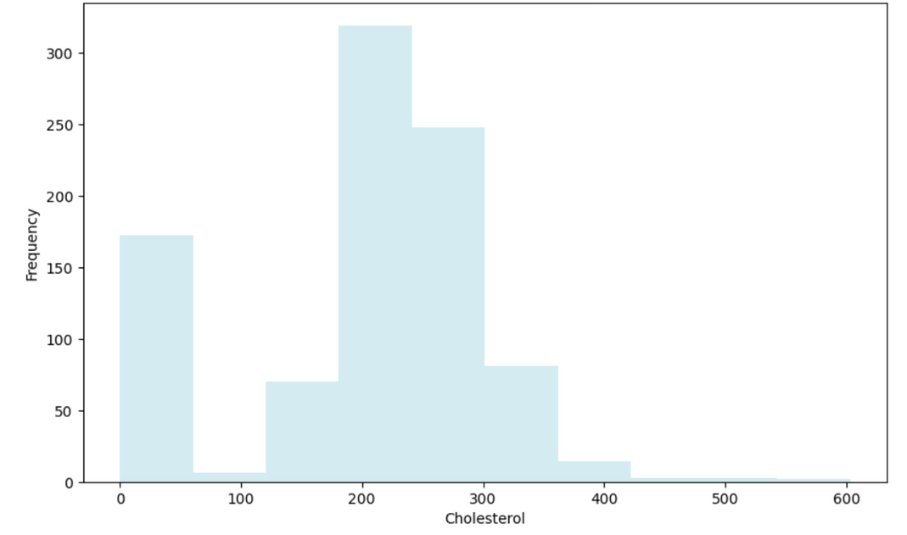
Data graphs

Slide 6
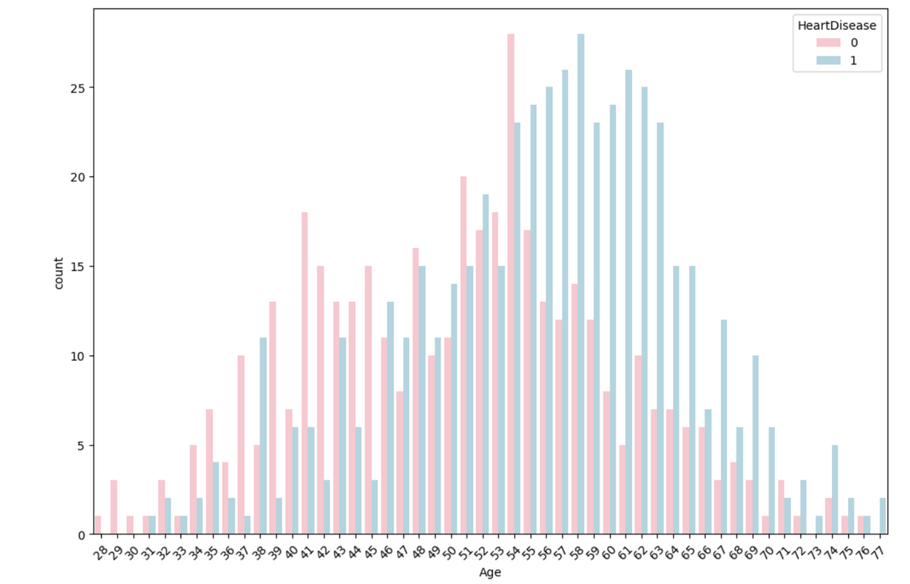
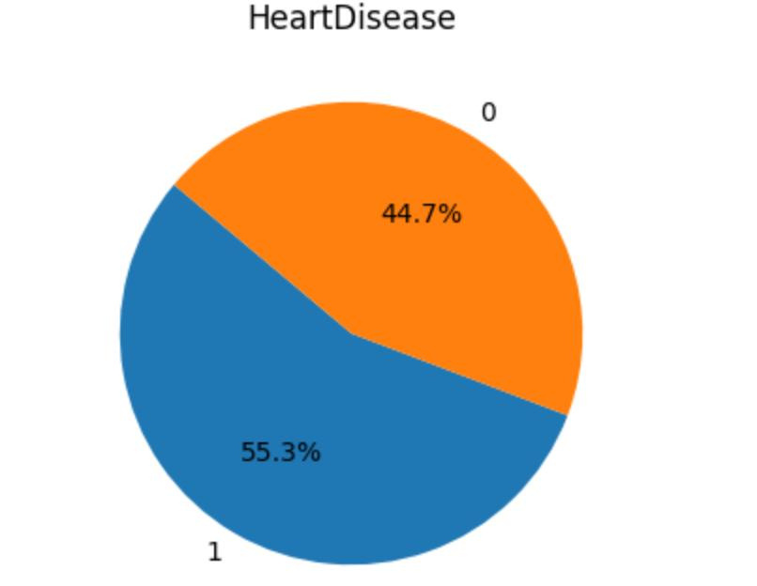
Data graphs

Slide 7




Data preprocessing
To achieve better accuracy, we used different techniques to get the data ready. First, we cleaned the data to remove any errors or inconsistencies. Then, we transformed the data to make it easier to work with and analyze.
for that we applied several preprocessing techniques:
Data cleaning
Data transformation

Slide 8




Data cleaning
We examined our data for any missing or null values and removed the corresponding rows, and we noticed that there is no missing value.
we identified outliers in the numeric attributes and removed the rows containing these outliers.

Slide 9
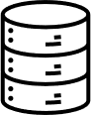

Transformation
We extracted non-numeric attributes, and we encode it to numeric values ,so we can do calculations on it.
(ChestPainType,RestingECG,ExerciseAngina,ST_Slope,Sex)
this transformation is crucial for preparing the data for analysis and modeling, making it compatible with various analytical techniques and algorithms that require numeric input.

Slide 10
Normalization
Normalization is where the attribute data are scaled so as to fall within a smaller range (0-1). We used normalization to four attributes.
['RestingBP', 'Cholesterol', 'MaxHR', 'Oldpeak']

Slide 11


Discretization
Continuous age values were transformed into specific intervals.
The purpose was to simplify analysis by dividing ages into three meaningful groups: (28, 44], (45, 59], and (60 and above].
This categorization provided a clearer framework for understanding age distributions.
It helped to evaluate how different age groups might impact our analyses.

Slide 12
Data mining task
In our project, we applied two data mining tasks to predict the likelihood of having heart disease.
Supervised
learning
Unsupervised
learning
(Classification)
(Clustring)

Slide 13

Classification
classification is supervised learning, in our project we trained our model to predict the class label (Heart Disease) based on other attributes, and we used a decision tree which is a recursive algorithm generates a tree where leaf nodes representing the final decision.

Slide 14
Classification
We divide our data set in to Training set and tasting set and we try Tree different partition size and two attributes selection which is information gain and Gini index.
the pattition size:
90% training set
10% testing set
80% training set
20% testing set
70% training set
30% testing set

Slide 15
Classification
We extract from the confusion matrix this result that appears in the table
90% training set 10% testing set
70% training set 30% testing set
80% training set 20% testing set
Gini
IG
Gini
IG
Gini
IG
Accuracy
0.7848
0.7721
0.7796
0.7839
0.7962
0.7834
Sensitivity
0.775
0.775
0.7348
0.7576
0.7701
0.7241
Specificity
0.7948
0.7692
0.8365
0.8173
0.8286
0.8571
0.7948
Precision
0.775
0.8509
0.8403
0.8481
0.8630

Slide 16

Findings
-Tree that has partition 20 testing set has the best algorithm overall since it has the highest accuracy (0.7962) among all models, while still have relatively good sensitivity, specificity, and precision.
-We notice that factors such as 'Cholesterol', 'MaxHR' (Maximum Heart Rate), and 'Age' are pivotal in predicting the presence of heart disease.

Slide 17
Cluestring
Clustering is an unsupervised learning technique used to group sets of objects in such a way that objects in the same group (called a cluster) are more similar to each other than to those in other groups.

Slide 18
Findings
K-Means Clustering Metrics:
K = 2: Inertia = 6945.635213379865, Silhouette = 0.18791654211461215
K = 3: Inertia = 6333.356653891398, Silhouette = 0.1789440351771225
K = 4: Inertia = 5800.545279018008, Silhouette = 0.15975110338328263
K = 5: Inertia = 5481.127731865022, Silhouette = 0.16126957413614387
K = 6: Inertia = 5267.0169929470485, Silhouette = 0.1565716191578228
K = 7: Inertia = 5051.651349301543, Silhouette = 0.15632795513791026
K = 8: Inertia = 4919.001918883268, Silhouette = 0.14571237057824524
K = 9: Inertia = 4719.683953080366, Silhouette = 0.13287725389930646
K = 10: Inertia = 4580.617088885884, Silhouette = 0.12233530130179494

Slide 19
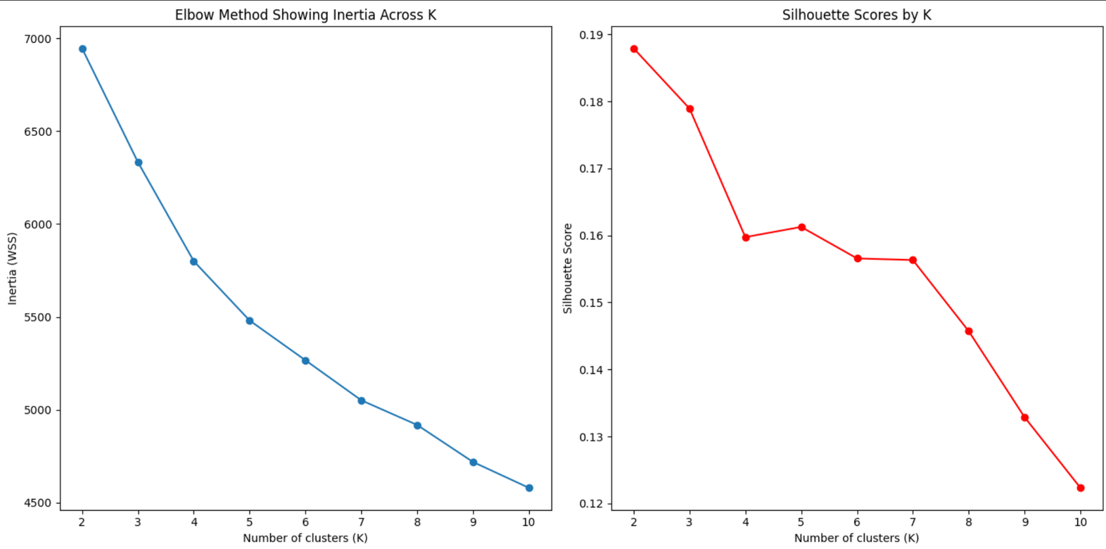
Findings

Slide 20
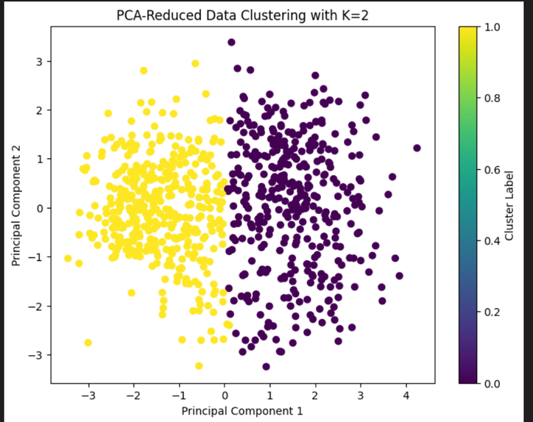
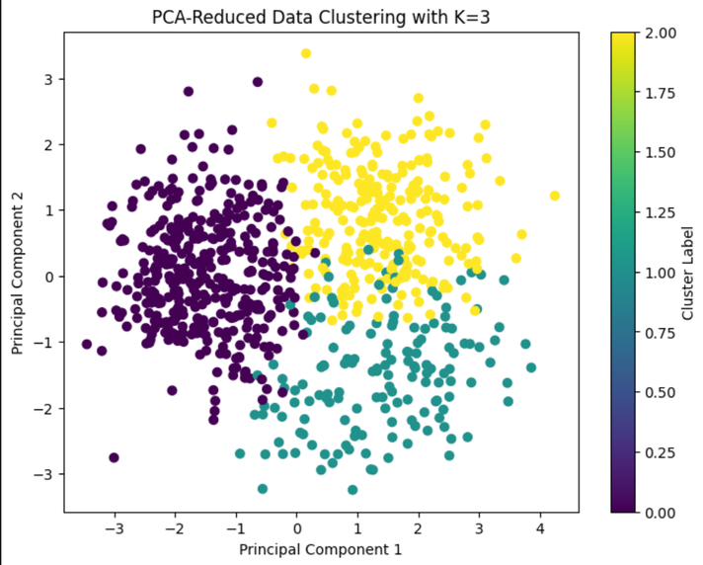
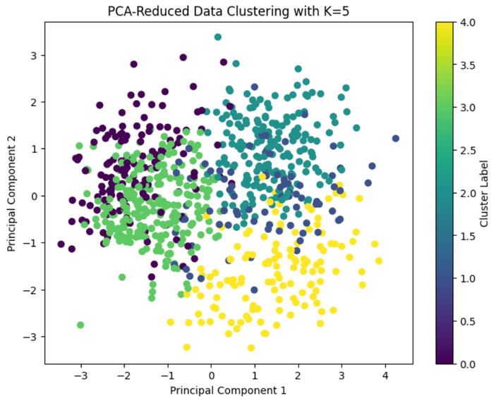
Findings

Slide 21
Do you have any questions?

Slide 22
Thank
You
:Team members
Njood Alowaidah
Almaha Aldahmash
shahad basalamah
Alanoud

